Slide 1
Introduction To Design Patterns and Exception Handling

Slide 2
Creational Design Patterns
Factory Pattern
Abstract Factory Pattern
Builder Pattern
Singleton Pattern
Prototype Pattern
Object Pool Pattern

Slide 3
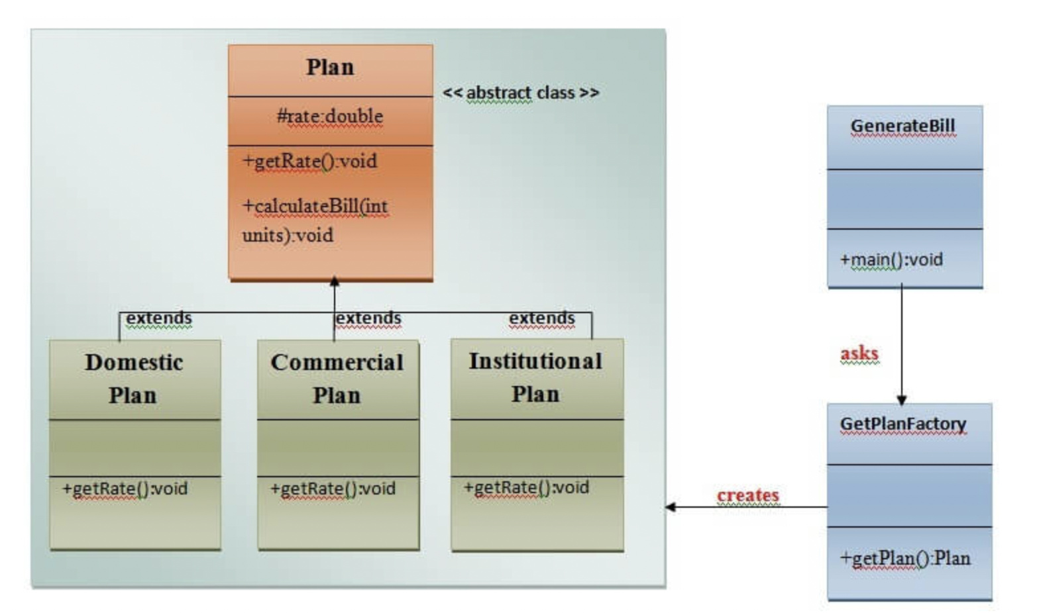
Factory Design Pattern

Slide 4
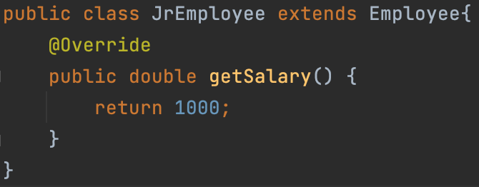
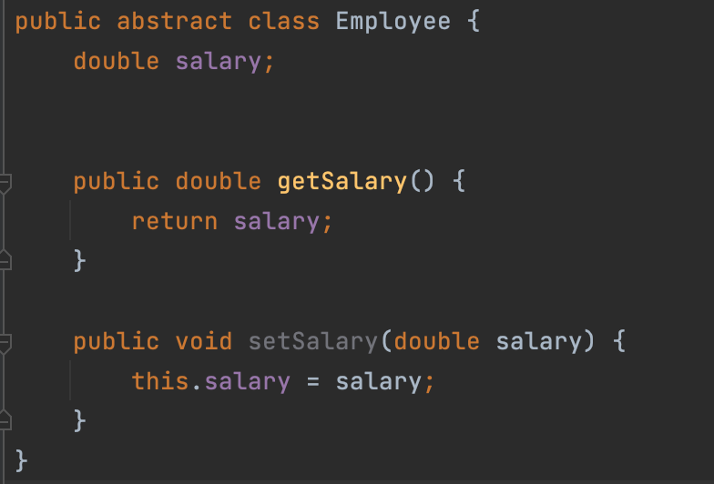
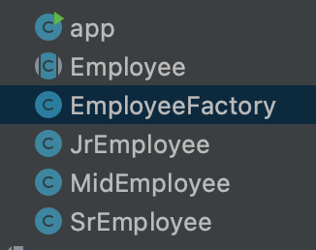
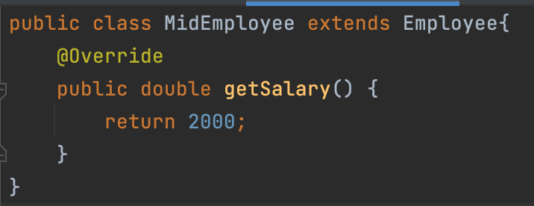
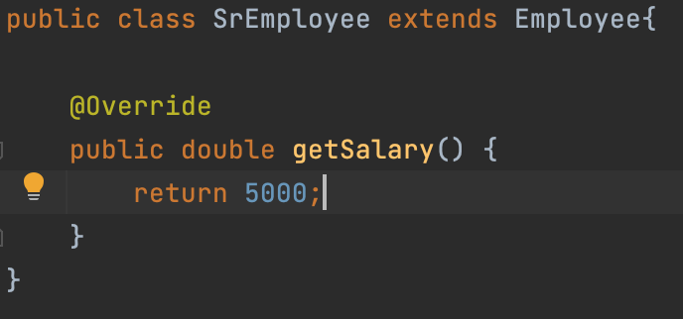
Implementation

Slide 5
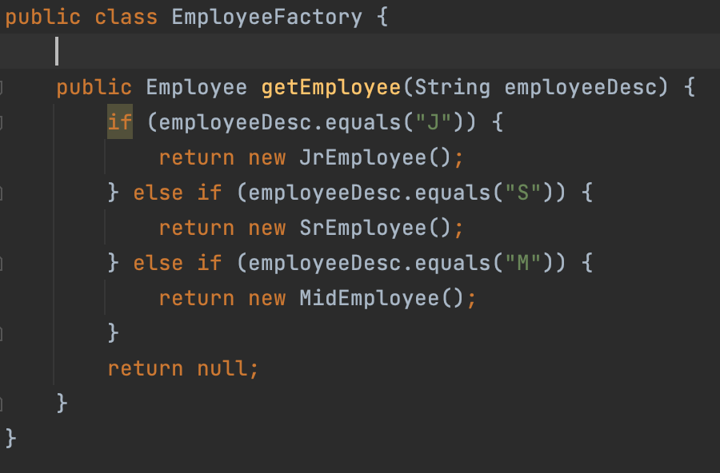
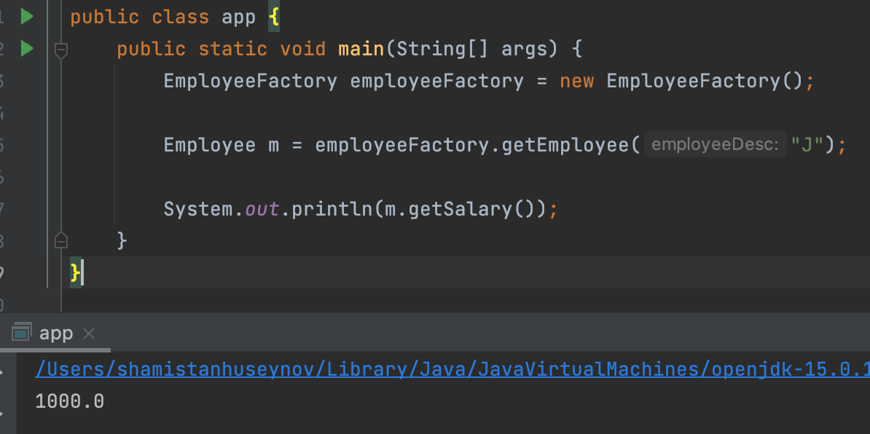
Implementation

Slide 6
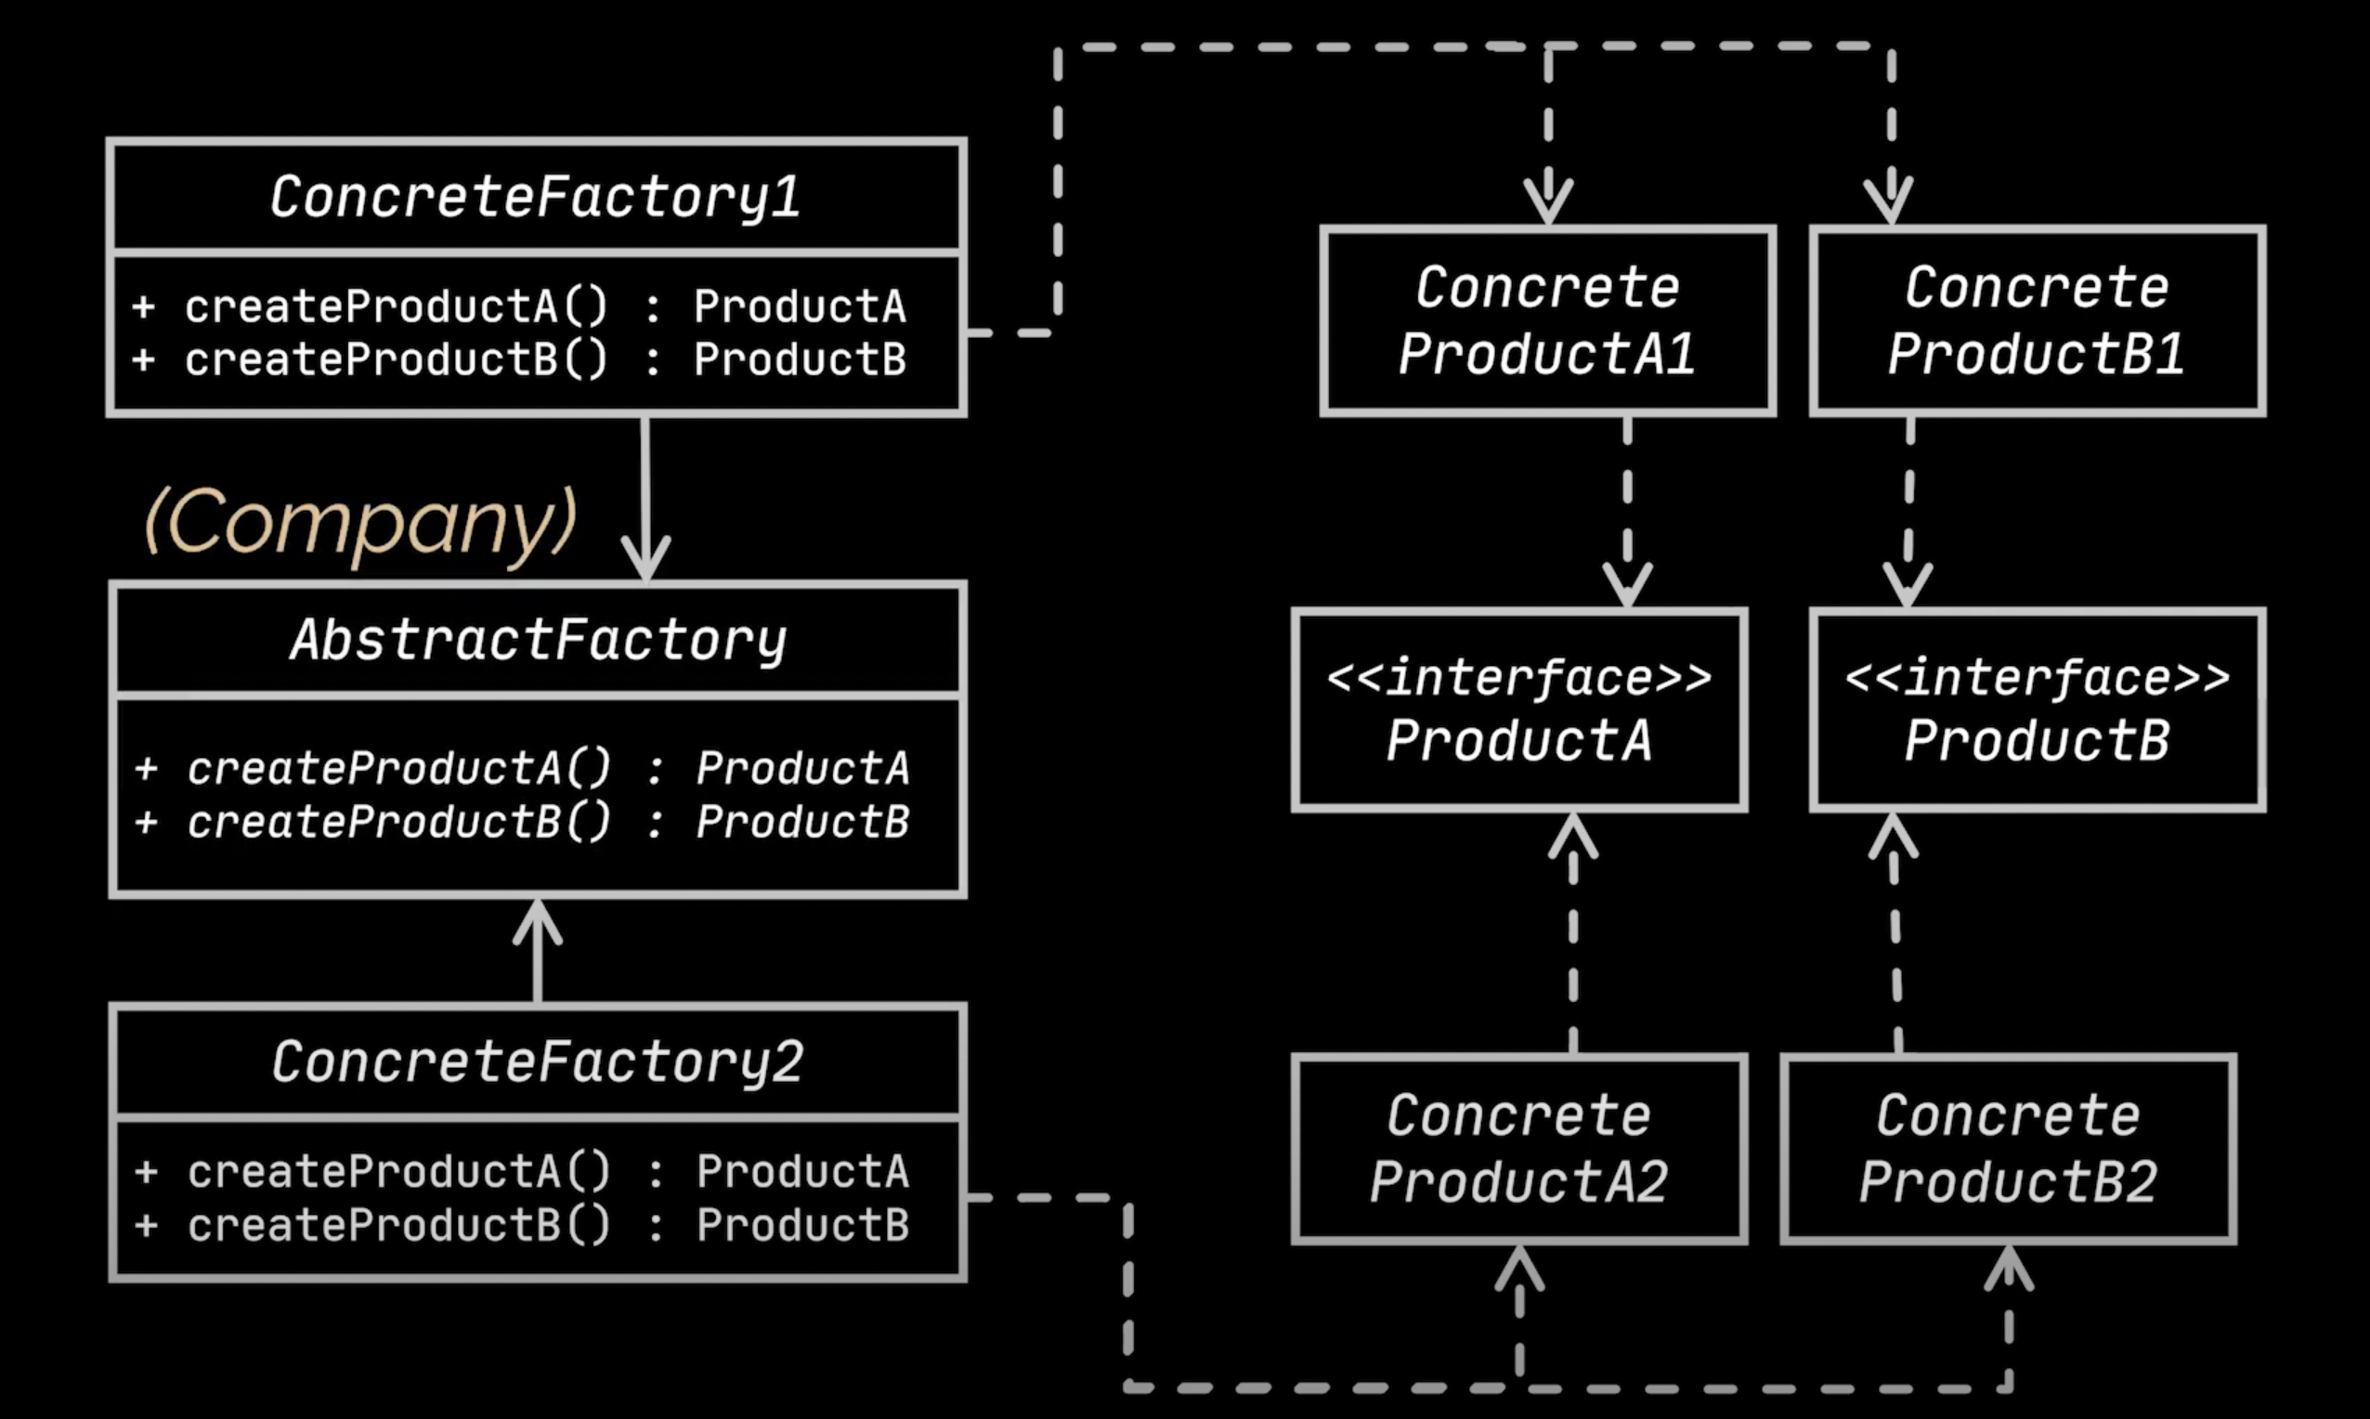
Abstract Design Pattern

Slide 7
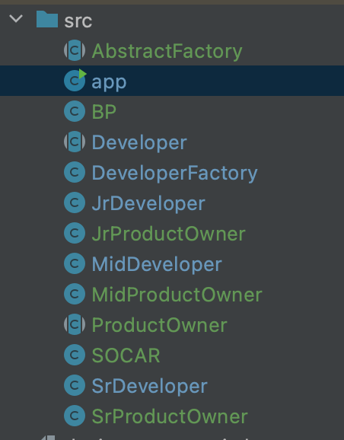
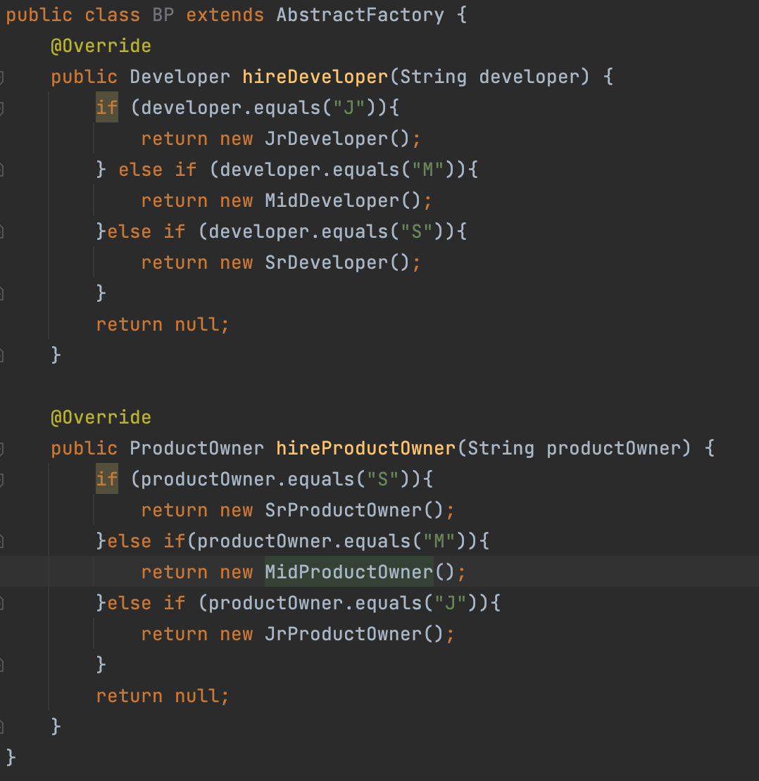
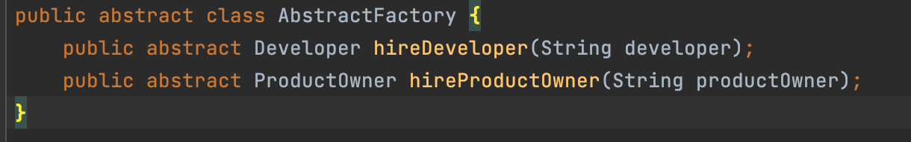
Abstract Factory Design Pattern

Slide 8
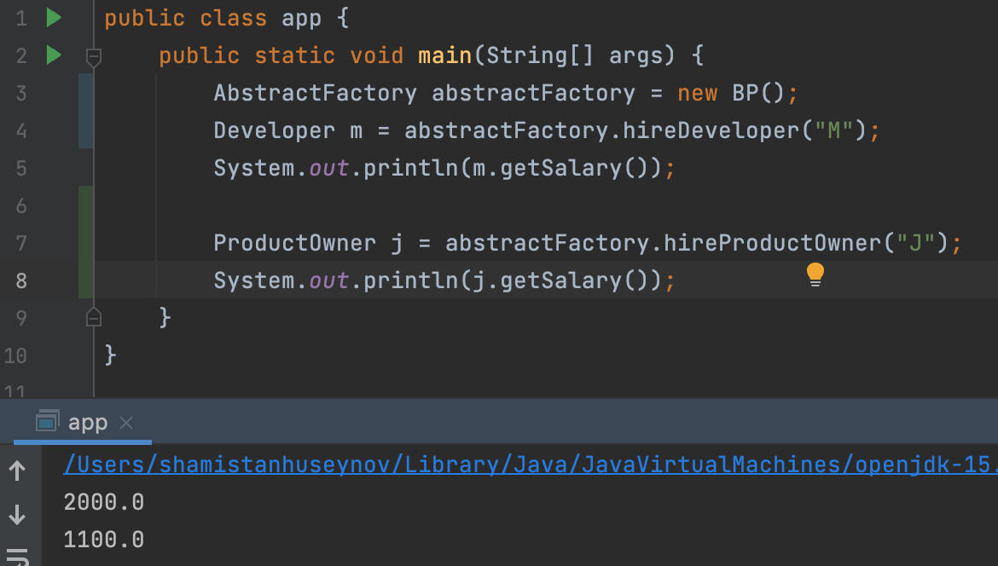
Implementation

Slide 9
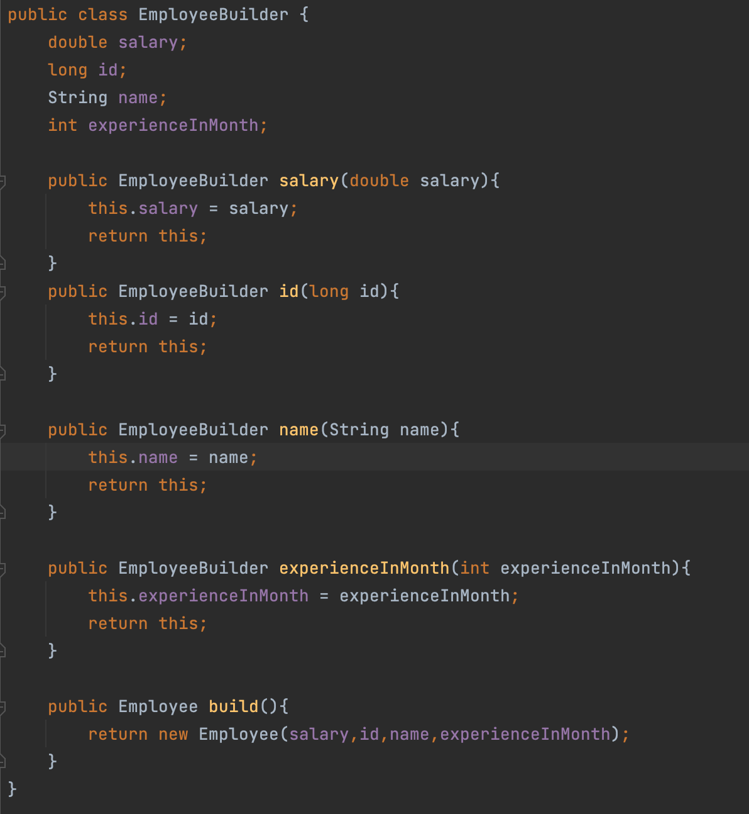
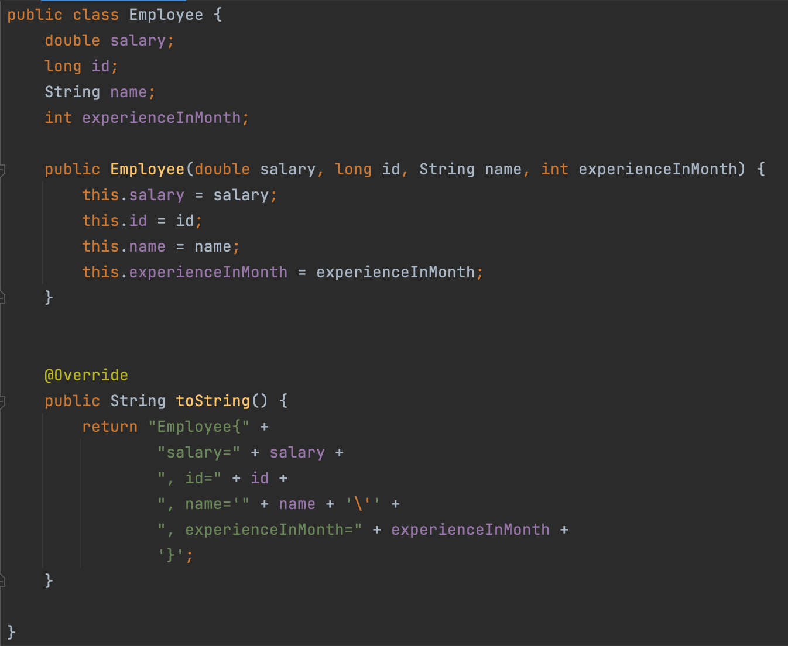
Builder Design Pattern

Slide 10
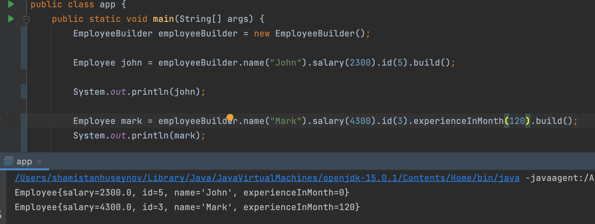
Builder Design Pattern

Slide 11
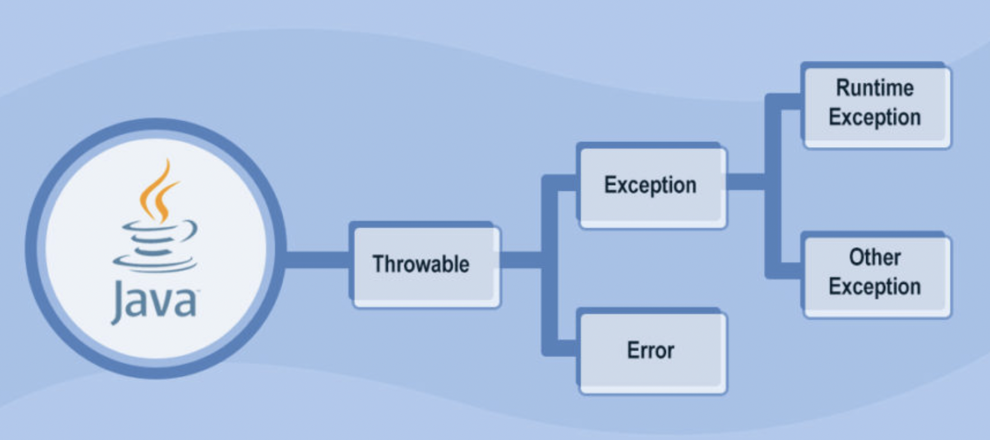
Exception Handling

Slide 12
Exceptions vs Errors
Error indicates a problem that mainly occurs due to the lack of system resources and our application should not catch these types of problems. Some of the examples of errors are system crash error and out of memory error. Errors mostly occur at runtime that's they belong to an unchecked type.
Exceptions are the problems which can occur at runtime and compile time. It mainly occurs in the code written by the developers. Exceptions are divided into two categories such as checked exceptions and unchecked exceptions.

